Slide 1

Microsoft Teams User Group Berlin
25. April 2024
Meetup #29

Slide 2

https://spirit21.com

Slide 3


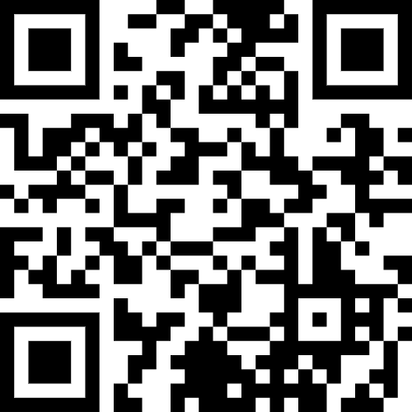
https://www.enowsoftware.com

Slide 4
Agenda
18:00 - 18:15 | Landing Zone
18:15 - 19:00 | Virtuelle Termine Thomas Stensitzki
19:15 - 19:45 | Microsoft Teams Neuigkeiten Thomas Stensitzki (@stensitzki, @stensitzki.bsky.social)
 | Organisatorisches
Dieses Meeting wird aufgezeichnet und online auf YouTube bereitgestellt. This meeting will be recorded and made available online.

Slide 5

Virtuelle Termine mit Microsoft Teams (Premium)
Thomas Stensitzki
@teamsugberlin.bsky.social #MicrosoftTeams #TeamsUGBerlin

Slide 6

Demo

Slide 7
Neues in Microsoft Teams Ankündigungen & Rollouts
Updates
Meetup #29
Thomas Stensitzki
@teamsugberlin.bsky.social #MicrosoftTeams #TeamsUGBerlin

Slide 8
Neues in Microsoft Teams Ankündigungen & Rollouts
Updates
Meetup #28 Thomas Stensitzki

Slide 9
Neuigkeiten in Microsoft Teams
Disable attendee emails for town halls and webinars
New Microsoft Teams for Web – GA for Firefox, Safari, and Linux
Pre-pin meeting apps for users
Latest meeting experiences with performance improvements on web for Safari and Firefox (for guests)
In form meeting option updates for webinars and townhalls
Hide General Channels
Meeting invite improvements

Slide 10
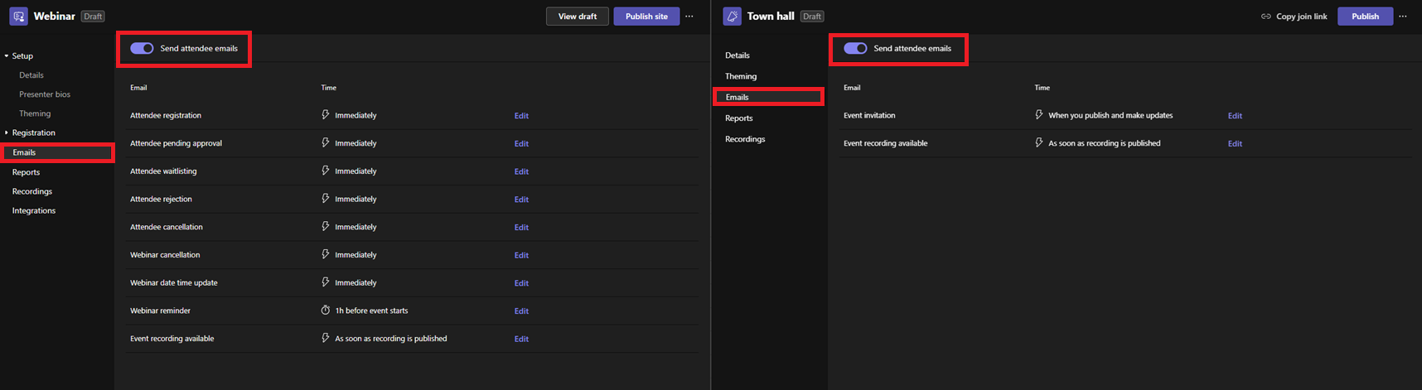
Disable attendee emails for town halls and webinars
Rollout-Verhalten → Aktivierter Versand von Nachrichten

Slide 11
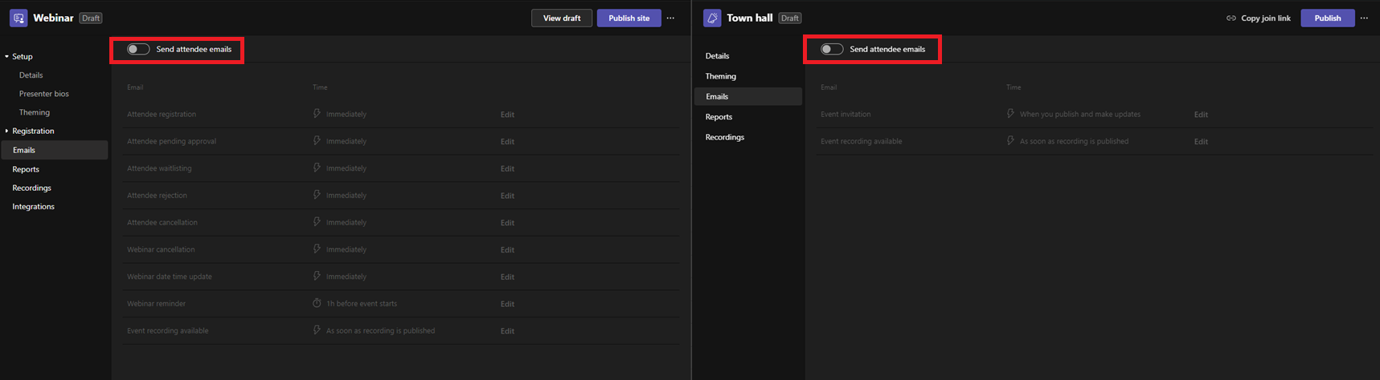
Disable attendee emails for town halls and webinars

Slide 12
Neuigkeiten in Microsoft Teams
Disable attendee emails for town halls and webinars
New Microsoft Teams for Web – GA for Firefox, Safari, and Linux
Pre-pin meeting apps for users
Latest meeting experiences with performance improvements on web for Safari and Firefox (for guests)
In form meeting option updates for webinars and townhalls
Hide General Channels
Meeting invite improvements

Slide 13
New Microsoft Teams for Web GA for Firefox, Safari, and Linux
Unterstützung für letzten drei Firefox-Versionen und die letzten zwei Safari-Versionen
Firefox und Safari folgt der gleichen Timeline für den neuen Teams-Client
Teams für Web-Nutzenden steht bis Mitte Mai die Schaltfläche für einen Wechsel zum alten Teams-Client zur Verfügung, auch wenn die Teams Update-Richtlinie auf "New Teams Only" konfiguriert ist
Weitere Informationen

Slide 14
Neuigkeiten in Microsoft Teams
Disable attendee emails for town halls and webinars
New Microsoft Teams for Web – GA for Firefox, Safari, and Linux
Pre-pin meeting apps for users
Latest meeting experiences with performance improvements on web for Safari and Firefox (for guests)
In form meeting option updates for webinars and townhalls
Hide General Channels
Meeting invite improvements

Slide 15
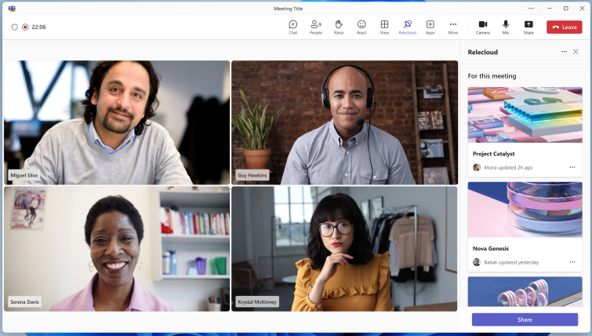
Pre-pin meeting apps for users
Notes:
This new feature enhances the customization of Microsoft Teams for users by highlighting the most important meeting apps for them. Admins can choose the meeting apps to pre- pin and pre-install, streamlining the user's experience, especially during meetings. The pinned apps will appear in the meeting app flyout and the meetings tabs next to chat.

Slide 16
Neuigkeiten in Microsoft Teams
Disable attendee emails for town halls and webinars
New Microsoft Teams for Web – GA for Firefox, Safari, and Linux
Pre-pin meeting apps for users
Latest meeting experiences with performance improvements on web for Safari and Firefox (for guests)
In form meeting option updates for webinars and townhalls
Hide General Channels
Meeting invite improvements

Slide 17
Latest meeting experiences with performance improvements on web for Safari and Firefox (for guests)
Notes:
We make constant steps to improve Teams performance irrespective of the platform – this time we are making the experience of Teams meetings on web (in Safari and Firefox browsers) better for anonymous users (guests). That’s crucial because it improves external collaboration. For example, if participants from your tenant would like to have meetings with non-Teams users (who are often joining as guests) it’ll become simpler as guests joining meeting from Safari/Firefox web browsers won’t have to wait significant amount of time for the meeting experience to load.
You may also notice that currently meeting UI in Chrome and Safari/Firefox is different, but with this update it won’t be a case anymore and you’ll enjoy all the benefits of modern UI (such as meeting toolbar on top of the screen, etc).

Slide 18
Neuigkeiten in Microsoft Teams
Disable attendee emails for town halls and webinars
New Microsoft Teams for Web – GA for Firefox, Safari, and Linux
Pre-pin meeting apps for users
Latest meeting experiences with performance improvements on web for Safari and Firefox (for guests)
In form meeting option updates for webinars and townhalls
Hide General Channels
Meeting invite improvements

Slide 19
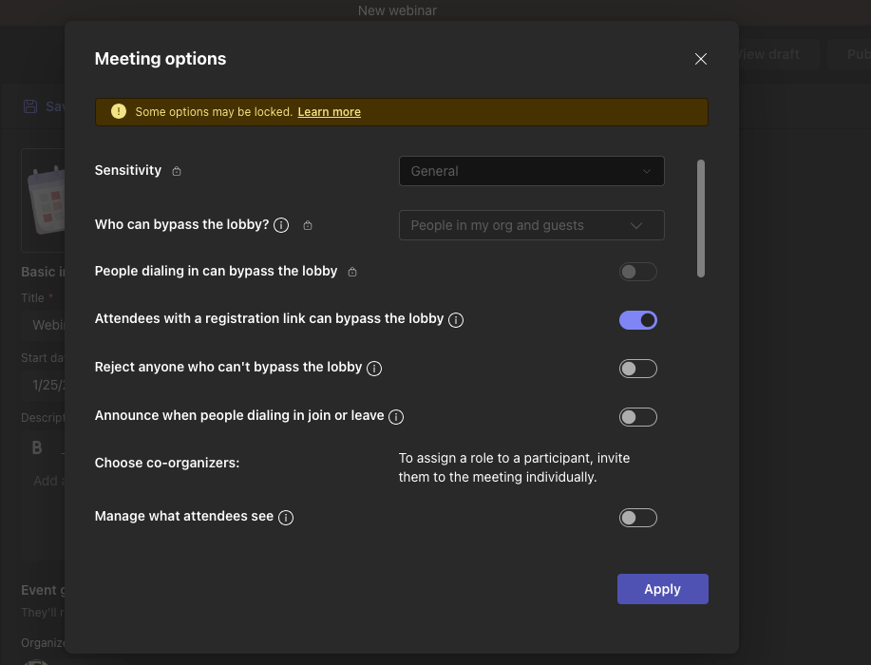
In form meeting option updates for webinars and townhalls
Notes:
In Microsoft Teams, configuring meeting options for events like webinars and townhalls required users to be taken to a web page after the event had been created. In order to optimize the user experience, we will now allow users to configure meeting options within the Teams app before event creation. This will provide users with more flexibility.

Slide 20
Neuigkeiten in Microsoft Teams
Disable attendee emails for town halls and webinars
New Microsoft Teams for Web – GA for Firefox, Safari, and Linux
Pre-pin meeting apps for users
Latest meeting experiences with performance improvements on web for Safari and Firefox (for guests)
In form meeting option updates for webinars and townhalls
Hide General Channels
Meeting invite improvements

Slide 21
Neuigkeiten in Microsoft Teams
Disable attendee emails for town halls and webinars
New Microsoft Teams for Web – GA for Firefox, Safari, and Linux
Pre-pin meeting apps for users
Latest meeting experiences with performance improvements on web for Safari and Firefox (for guests)
In form meeting option updates for webinars and townhalls
Hide General Channels
Meeting invite improvements

Slide 22
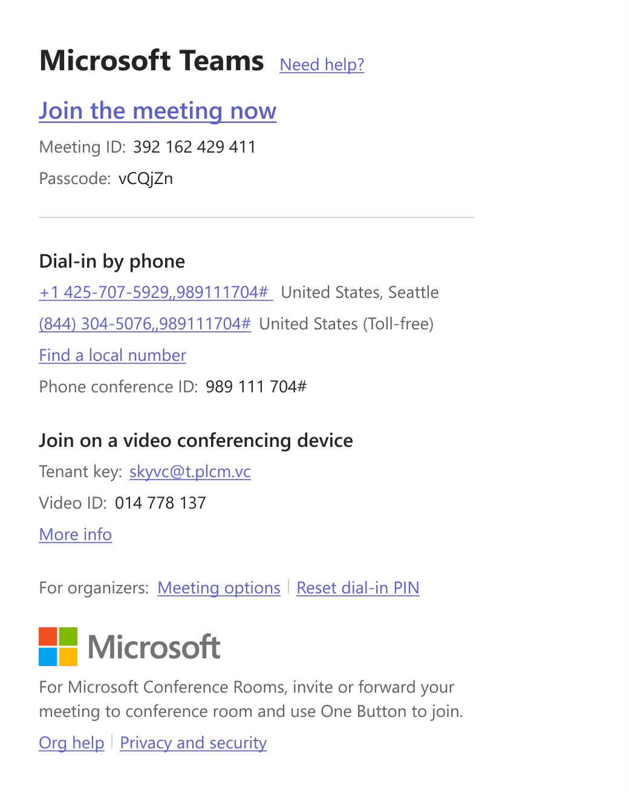
Meeting invite improvements

Slide 23
Neuigkeiten in Microsoft Teams
Share contact information of people in Microsoft Teams chat
Sensitivity Labels enabled in Teams Mobile Meetings
Apps now supported in group chats with external users
Additional Teams Meeting Templates Added to Outlook Teams Add-In
Discover Feed in Channels

Slide 24
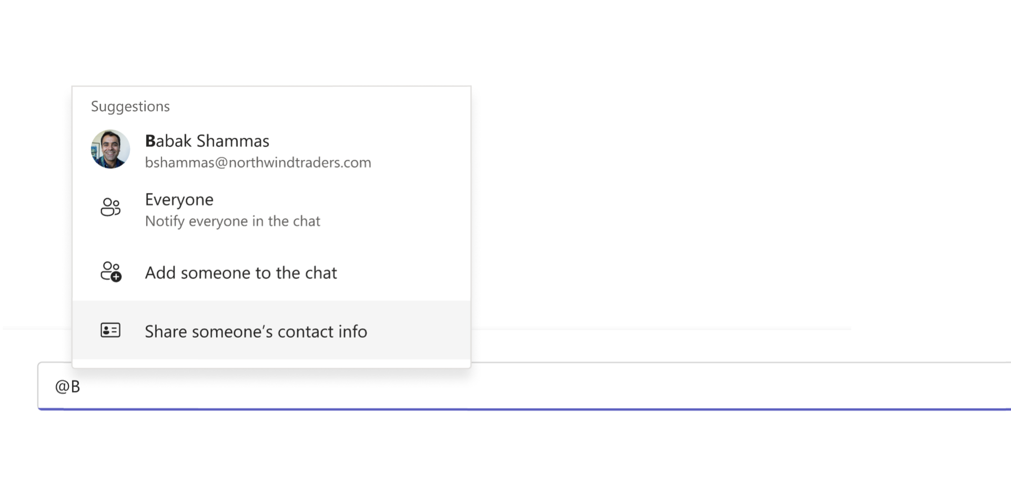
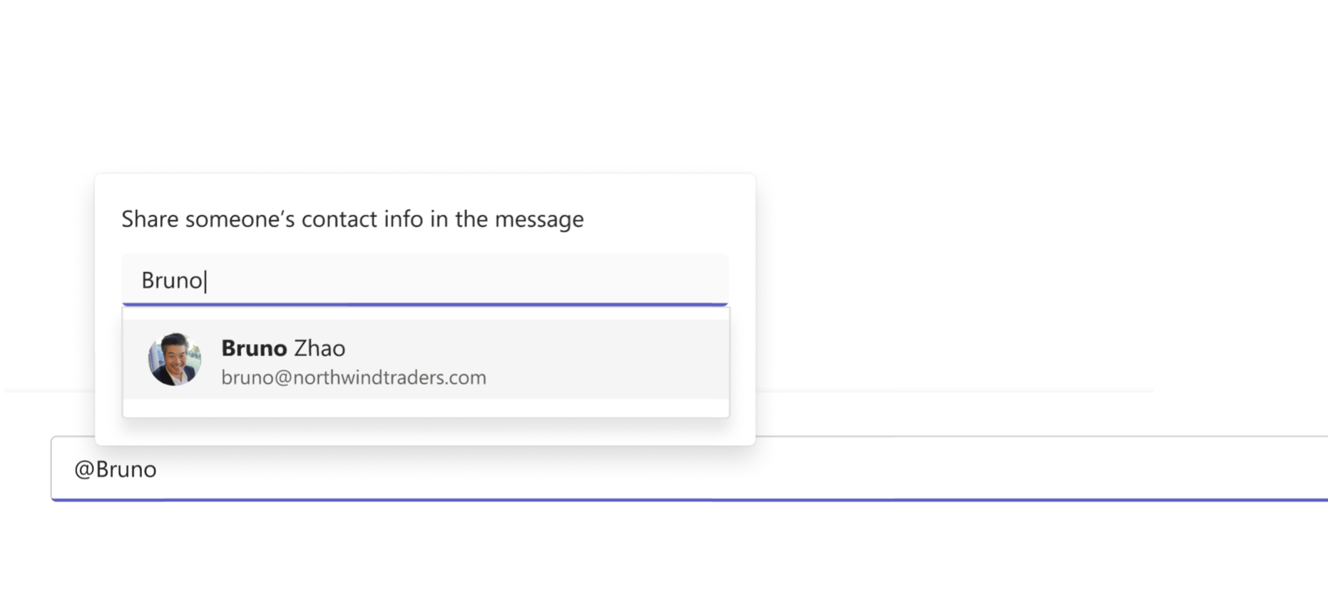
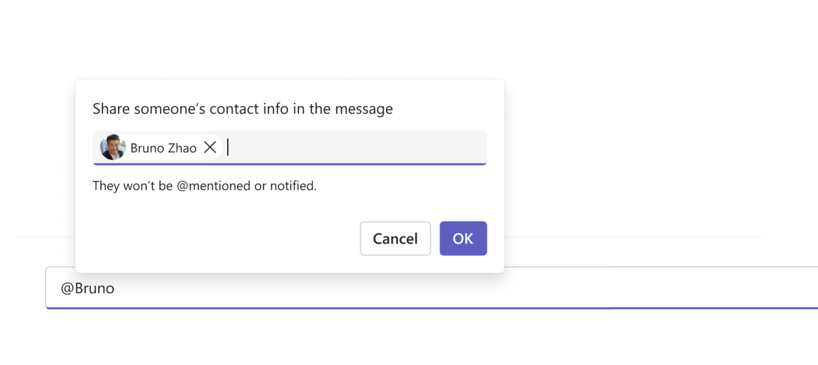
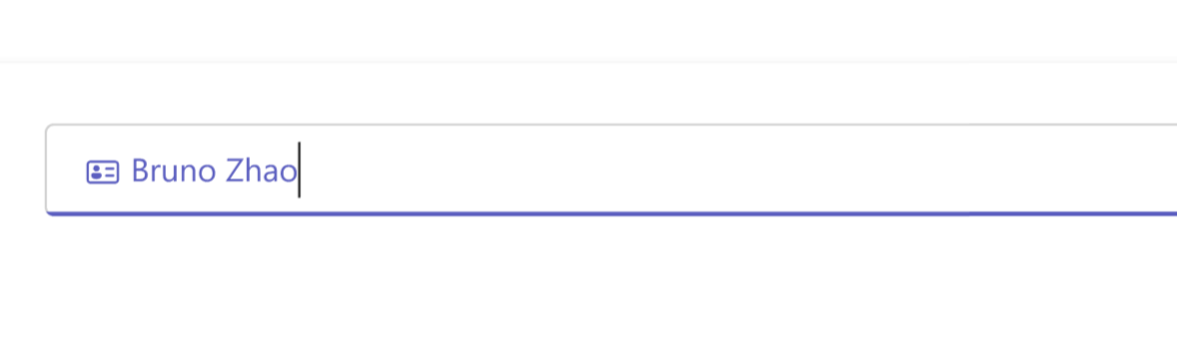
Share contact information of people in Microsoft Teams chat

Slide 25
Neuigkeiten in Microsoft Teams
Share contact information of people in Microsoft Teams chat
Sensitivity Labels enabled in Teams Mobile Meetings
Apps now supported in group chats with external users
Additional Teams Meeting Templates Added to Outlook Teams Add-In
Discover Feed in Channels

Slide 26
Neuigkeiten in Microsoft Teams
Share contact information of people in Microsoft Teams chat
Sensitivity Labels enabled in Teams Mobile Meetings
Apps now supported in group chats with external users
Additional Teams Meeting Templates Added to Outlook Teams Add-In
Discover Feed in Channels

Slide 27
Apps now supported in group chats with external users
Nur der Gastgeber des Gruppenchats kann Apps bereitstellen, die von allen Teilnehmenden genutzt werden können
Die Zugriffsrichtlinien für Apps werden beachtet
Dies gilt nur für Gruppenchats, nicht für 1:1-Chats oder Kanalchats mit externen Teilnehmenden
Externer Zugriff und Datenverarbeitung erfolgen zu den Bedingungen des App-Anbieters

Slide 28
Neuigkeiten in Microsoft Teams
Share contact information of people in Microsoft Teams chat
Sensitivity Labels enabled in Teams Mobile Meetings
Apps now supported in group chats with external users
Additional Teams Meeting Templates Added to Outlook Teams Add-In
Discover Feed in Channels

Slide 29
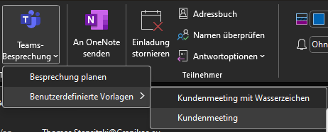
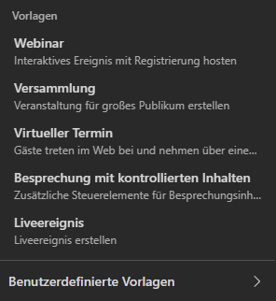
Additional Teams Meeting Templates Added to Outlook Teams Add-In
Outlook Teams Add-In Vorlagen für
Virtueller Termin
Webinar
Versammlung
Weitere Informationen

Slide 30
Neuigkeiten in Microsoft Teams
Share contact information of people in Microsoft Teams chat
Sensitivity Labels enabled in Teams Mobile Meetings
Apps now supported in group chats with external users
Additional Teams Meeting Templates Added to Outlook Teams Add-In
Discover Feed in Channels

Slide 31
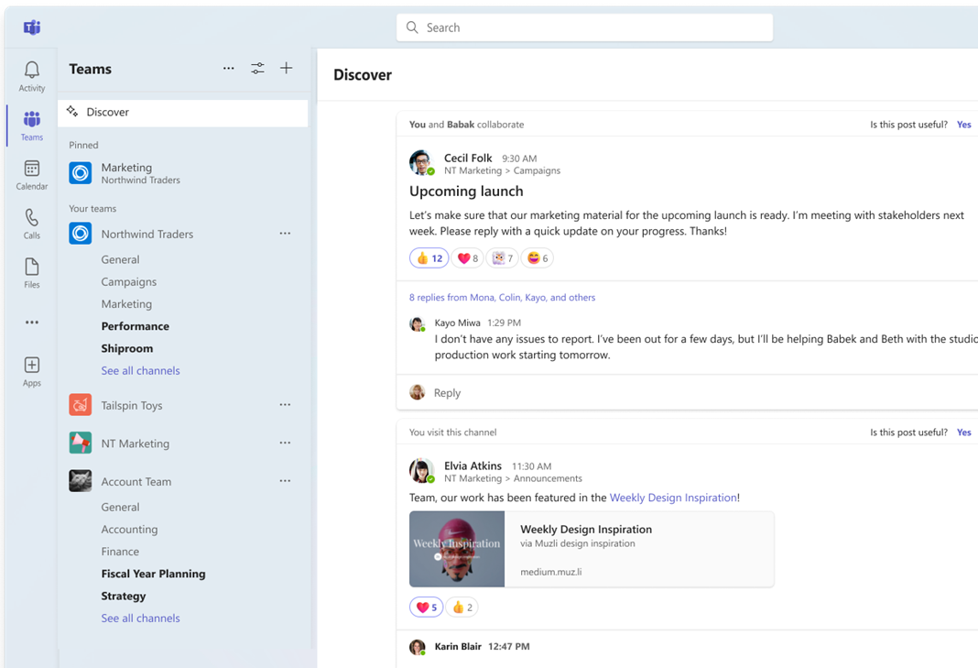
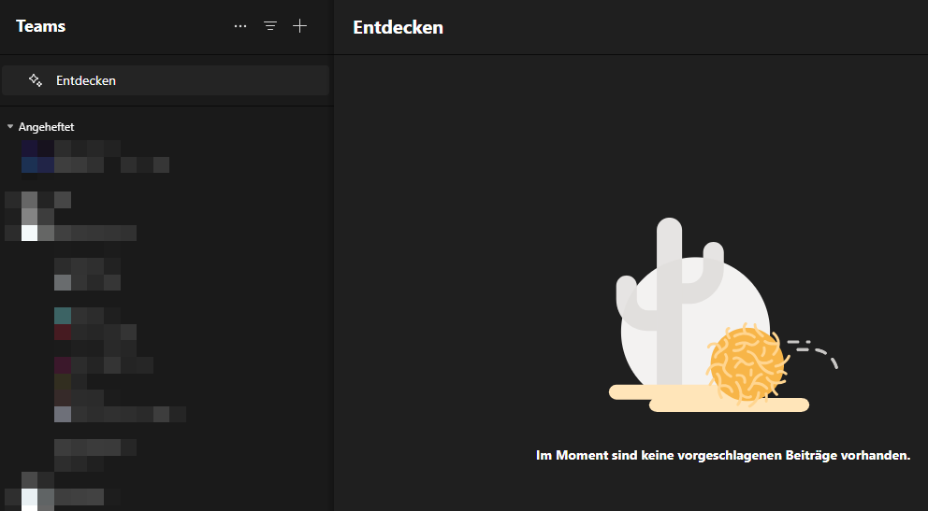
Discover Feed in Channels

Slide 32
Neues in Microsoft Teams Ankündigungen & Rollouts für Admins
Updates
Meetup #29
Thomas Stensitzki
@teamsugberlin.bsky.social #MicrosoftTeams #TeamsUGBerlin

Slide 33
Neues in Microsoft Teams Ankündigungen & Rollouts für Admins
Updates
Meetup #28 Thomas Stensitzki

Slide 34
Neuigkeiten in Microsoft Teams für Admins
Tenant-wide policy for permission to download meeting transcription
Tags in Shared Channels for Microsoft Teams
In-meeting Error Messaging
Ensuring Enhanced Noise Suppression and other advanced features work as expected
Changes to Administrator Permissions Required to Create and Manage Teams Resource Accounts
Simplified sign in for iOS and Android devices

Slide 35
Tenant-wide policy for permission to download meeting transcription
Richtlinie zur Kontrolle des Downloads von Transkripten
Admin-kontrollierte Ausnahmen per Sicherheitsgruppe
Standardberechtigung für Transskripte wird nach Rollout angepasst
Targeted Release: Mai 2024
GA: August 2024

Slide 36
Neuigkeiten in Microsoft Teams für Admins
Tenant-wide policy for permission to download meeting transcription
Tags in Shared Channels for Microsoft Teams
In-meeting Error Messaging
Ensuring Enhanced Noise Suppression and other advanced features work as expected
Changes to Administrator Permissions Required to Create and Manage Teams Resource Accounts
Simplified sign in for iOS and Android devices

Slide 37
Neuigkeiten in Microsoft Teams für Admins
Tenant-wide policy for permission to download meeting transcription
Tags in Shared Channels for Microsoft Teams
In-meeting Error Messaging
Ensuring Enhanced Noise Suppression and other advanced features work as expected
Changes to Administrator Permissions Required to Create and Manage Teams Resource Accounts
Simplified sign in for iOS and Android devices

Slide 38
Neuigkeiten in Microsoft Teams für Admins
Tenant-wide policy for permission to download meeting transcription
Tags in Shared Channels for Microsoft Teams
In-meeting Error Messaging
Ensuring Enhanced Noise Suppression and other advanced features work as expected
Changes to Administrator Permissions Required to Create and Manage Teams Resource Accounts
Simplified sign in for iOS and Android devices

Slide 39
Ensuring Enhanced Noise Suppression and other advanced features work as expected
Erreichbarkeit von für alle User
→ https://aiinfrastructure.static.microsoft
ID | Kategorie | ER (ExpressRoute) | Addressen | Ports
184 | Standard Erforderlich | Nein | *.cloud.microsoft, *.static.microsoft, *.usercontent.microsoft | TCP: 443, 80
Microsoft 365-URLs und IP-Adressbereiche
Notes:
Ensuring optimal audio and video quality during Microsoft Teams calls by allowing access to a specific URL as part of the preparation for the Noise Suppression feature.

Slide 40
Neuigkeiten in Microsoft Teams für Admins
Tenant-wide policy for permission to download meeting transcription
Tags in Shared Channels for Microsoft Teams
In-meeting Error Messaging
Ensuring Enhanced Noise Suppression and other advanced features work as expected
Changes to Administrator Permissions Required to Create and Manage Teams Resource Accounts
Simplified sign in for iOS and Android devices

Slide 41
Changes to Administrator Permissions Required to Create and Manage Teams Resource Accounts
Auswirkung auf die Erstellung und Verwaltung von Teams Phone Resource Accounts
Auto Attendants, Call Queues und Certified Teams Call Center Applikationen
Folgende Rollen verlieren die Berechtigung
Teams Administrator, Teams Communications Administrator, Teams Telephony Administrator
In Zukunft nur noch berechtigt
Microsoft 365 Global Admin oder User Admin
Stichtag: 15. Juli 2024

Slide 42
Neuigkeiten in Microsoft Teams für Admins
Tenant-wide policy for permission to download meeting transcription
Tags in Shared Channels for Microsoft Teams
In-meeting Error Messaging
Ensuring Enhanced Noise Suppression and other advanced features work as expected
Changes to Administrator Permissions Required to Create and Manage Teams Resource Accounts
Simplified sign in for iOS and Android devices

Slide 43
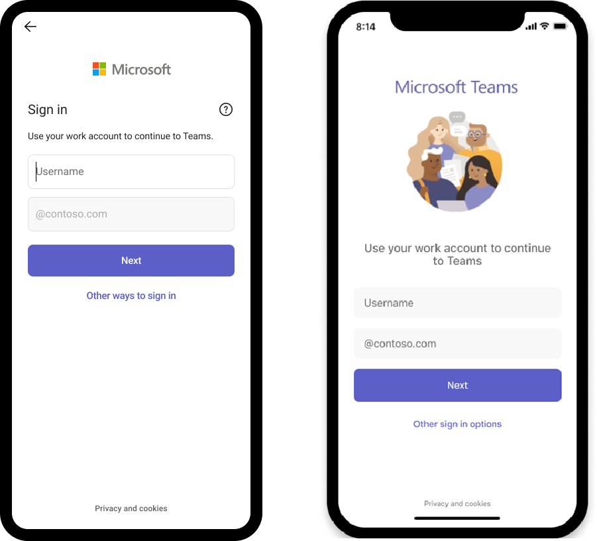
Simplified sign in for iOS and Android devices
Weitere Informationen
Notes:
Microsoft Teams admins will now have the capability to make sign in faster for iOS and Android device users by prefilling domain names using app configuration policies. This change will especially benefit frontline workers who frequently sign in and out of a shared device.

Slide 44
Neuigkeiten in Microsoft Teams für Admins
Cloud IntelliFrame: A New Way to See People in Teams Rooms
Watermark support for recording playback (Premium)

Slide 45
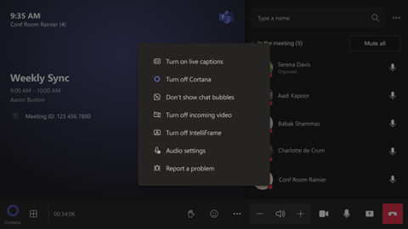
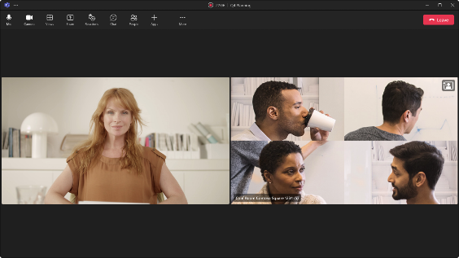
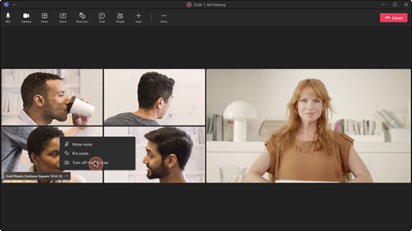
Cloud IntelliFrame: A New Way to See People in Teams Rooms
Automatische Nutzung mit Microsoft Teams Room on Windows mit einer Pro Lizenz
Weitere Informationen
Notes:
Microsoft Teams Rooms on Windows with Pro license will have Cloud IntelliFrame, which creates smart video feeds of in-room participants by zooming into their faces and eliminating distractions. It will roll out to commercial tenants in mid-August and complete by late April 2024. Users can disable IntelliFrame, and certain camera models will automatically use it. Large spaces may not be ideal, and users can switch it off in rooms with glass walls without privacy filters.

Slide 46
Cloud IntelliFrame: A New Way to See People in Teams Rooms
AVer CAM520 Pro
AVer CAM520 Pro2
BRIO 4K Stream Edition
EagleEye Cube USB
HD Pro Webcam C920
Jabra PanaCast
Logi Rally Camera
Logitech BRIO
Logitech ConferenceCam CC3000e
Logitech MeetUp
Logitech Webcam C925e
Logitech Webcam C930e
Microsoft® LifeCam Studio
Polycom EagleEye IV USB Camera
PTZ Pro 2
PTZ Pro Camera
ThinkSmart Cam
Yealink UVC30
Yealink UVC34
Yealink UVC50
Yealink UVC80
Yealink UVC86

Slide 47
Neuigkeiten in Microsoft Teams für Admins
Cloud IntelliFrame: A New Way to See People in Teams Rooms
Watermark support for recording playback (Premium)

Slide 48
Watermark support for recording playback (Premium)
Organisator und Co-Organisator können in einer geschützten Besprechung die Aufnahme starten
Nach Beendigung der Aufnahme können Teilnehmende den Aufzeichnungslink im Besprechungschat aufrufen
Aufzeichnung wird im Browser geöffnet und mit der individuellen E-Mail-Adresse als Wasserzeichen versehen
Download-Option ist nur für die Person verfügbar, die die Aufzeichnung gestartet hat (Dateieigentümer)

Slide 49
Microsoft Teams – Links
What's New in Microsoft Teams | Enterprise Connect 2024 Edition
What’s New in Microsoft Teams | February 2024
Microsoft Teams Blog
Microsoft Teams Community Blog
Microsoft Teams Feedback Portal

Slide 50
Offene Diskussion
@teamsugberlin.bsky.social #MicrosoftTeams #TeamsUGBerlin

Slide 51
Organisatorisches

Slide 52
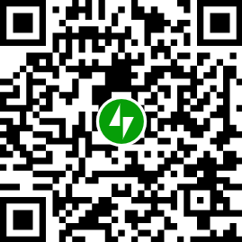
Organisatorisches
Microsoft Community Tenant für User Groups
Teilnahme als Microsoft 365 Gast
Anmeldung: https://go.granikos.eu/TeamsUGForm
Teams Meeting Teilnahme-Link
https://teamsusergroup.berlin/meetup
Teams User Group Aufzeichnungen
https://teamsusergroup.berlin/video
Teams User Group bei Bluesky
teamsugberlin.bsky.social

Slide 53

Vielen Dank für eure Teilnahme!
Das nächste Meetup:
→ 20. Juni 2024
https://TeamsUserGroup.Berlin/register
Spread the Word!
#TeamsUGBerlin
Aufzeichnungen unserer Meetups sind im Community Team und bei YouTube verfügbar Präsentationen sind als PPTX im Community Mandanten und bei GitHub verfügbar

